Slide 1
QUARKS
Quantum communication networks for society and industry
January 14, 2025

Slide 2
Agenda Headline2
Topic 1
Placeholder
Placeholder
Placeholder
Topic 2

Slide 3
Topic
Headline 1

Slide 4
Headline2
Topic 1 | Topic 2

Slide 5
Headline 3
Placeholder
Placeholder
Placeholder

Slide 6

Headline 3
LinkedIn
Placeholder

Slide 7
Headline 3
January - June
Placeholder (highlight colour)
Placeholder

Slide 8
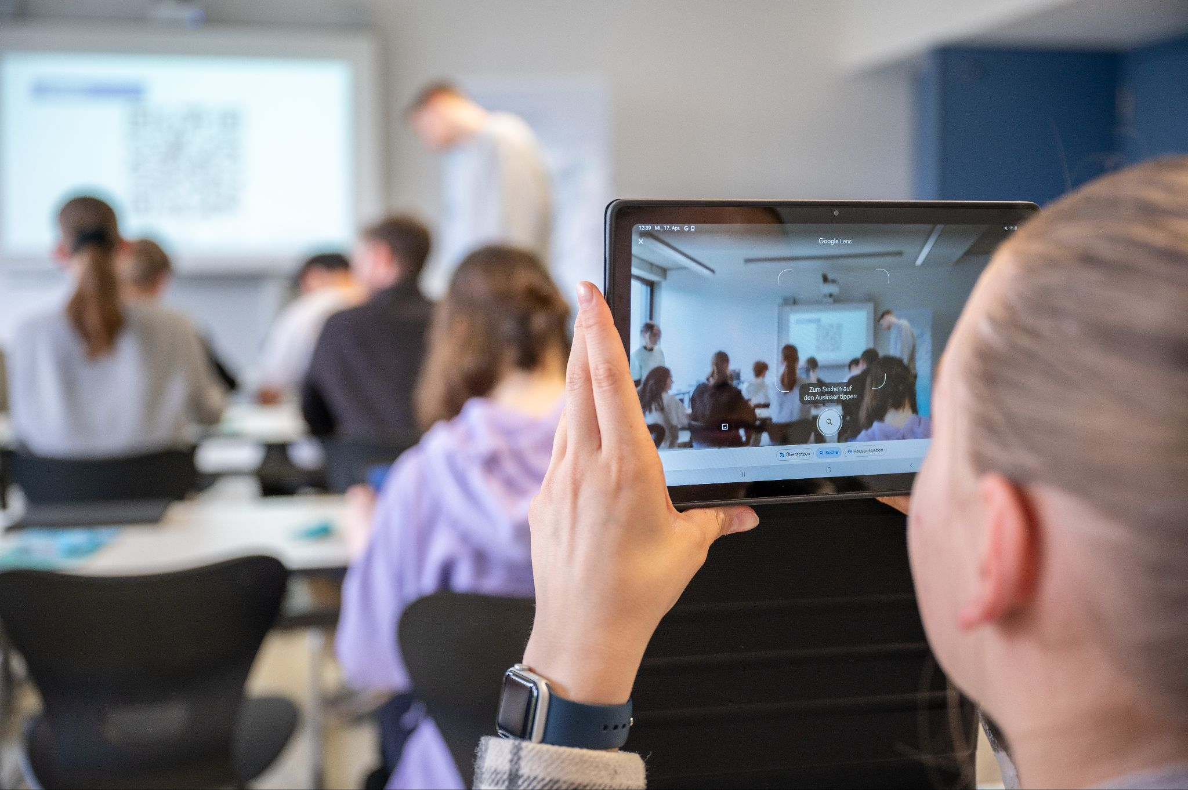
Headline 3
Placeholder
Placeholder

